Slide 1


Felipe Kohut

Slide 2

Outline
Executive Summary
Introduction
Methodology
Insights Drawn From E.D.A
Launch Sites Proximities
Dashboard
Predictive Analytics
Results
Conclusion
Appendix

Slide 3
Executive Summary
Problem Statement
According to CB Insights statistics, 20% of startups fail because they got outcompeted while 8% of startups were sunk because of poor products. Our competitor SpaceX, dominates the market because of the reusability of its rockets. To outcompete them, it is imperative to determine our product performance. In this case, we need a way to predict the landing outcome of our rockets after they are launched.
Solution
We collected data on SpaceX’s Falcon 9 rocket launches and used it to train Machine Learning models that will predict whether the first stage of the rocket will land successfully. This was done through the following ways:
Data Collection
Data Analysis
Predictive Modeling using Machine Learning Algorithms
Note that the data collection stage was carried out using API requests and Web Scraping in order to minimize costs.
Value
The predictive models enabled the company to determine the success of a rocket landing. This was especially important, because a failed landing could result in a loss of tens of millions of dollars. Furthermore, it enabled the company to determine costs and make more attractive offers than SpaceX.
Final Thoughts and Next Steps
Powerful Analytics and Machine Learning tools not only increase our competitiveness – they can also increase customer confidence in our offerings. With the attention of these offerings, we expect to break into a market projected to reach USD 26.16 billion by 2027. For more information, visit the full project repository: https://github.com/Felipekohut/SpaceX-Landing-Prediction

Slide 4
Introduction
The primary objective of this Data Science project is to allow the company to compete with SpaceX. In order to achieve this goal, it is necessary to predict if the first stage of the SpaceX Falcon 9 rocket will land successfully.
SpaceX advertises Falcon 9 rocket launches on its website, with a cost of 62 million dollars. Other providers cost upward of 165 million dollars each, much of the savings is because SpaceX can reuse the first stage.
Therefore if we can accurately predict the likelihood of the first stage rocket landing successfully, we can determine the cost of a launch. With the help of the Data Science findings and models, the company can make more informed bids against SpaceX for a rocket launch.

Slide 5

Section 1

Slide 6
Methodology
Executive Summary
Data collection methodology:
Make requests to the SpaceX API.
Perform web scraping to collect Falcon 9 historical launch records on the Wikipedia page titled: List of Falcon 9 and Falcon Heavy launches
Perform data wrangling
Clean the data and explore it to find patterns in the data to determine the labels for training supervised models.
Perform exploratory data analysis (EDA) using visualization and SQL
Perform interactive visual analytics using Folium and Plotly Dash
Perform predictive analysis using classification models
Create a machine learning pipeline to predict if the first stage will land given the data.
Train the best performing model to make accurate predictions.

Slide 7
Data Collection
The data collection stage is arguably the most crucial stage in the project. This is because we use data to train our machine learning models to make precise predictions.
There are different ways to go about collecting the data but we used two methods:
Data collection by SpaceX API request.
Data collection by Web Scraping
These are all low-cost methods that only require a functioning internet connection.

Slide 8
Data Collection – SpaceX API
Make request to SpaceX API
Decode the response content as a Json
Turn Json into pandas data frame
Use the API again to get information about the launches using the IDs given for each launch
Construct our dataset using the data we have obtained
Filter the dataframe to only include Falcon 9 launches
Replace null values in the data with the mean that was calculated
Convert data frame into a CSV dataset
Make a request to SpaceX API and make sure the data is in the correct format.
Perform some basic data wrangling and formatting in order to clean the requested data.
Convert our data frame into a CSV dataset.
URL link: https://github.com/Felipekohut/SpaceX-Landing-Prediction/blob/main/SpaceX-data-collection-api.ipynb

Slide 9
Data Collection - Web Scraping
Request the Falcon9 Launch Wiki page from its URL
Create a BeautifulSoup object from the HTML respone
Extract all column/variable names from the HTML table header
Create an empty dictionary with keys from the extracted column names
Fill up the dictionary with launch records extracted from table rows.
Convert the dictionary into a CSV dataset
Using BeautifulSoup, perform web scraping on the wikipedia page with title: List of Falcon 9 and Falcon Heavy launches
Store the launch records in an HTML table.
Parse the table and convert it into a CSV dataset.
URL link: https://github.com/Felipekohut/SpaceX-Landing-Prediction/blob/main/SpaceX-webscraping.ipynb

Slide 10
Data Wrangling
The goal in this stage is to find patterns in the data and determine the label for training supervised machine learning models.
In the data set, there are several different cases where the rocket did not land successfully. For example, True RTLS means the rocket successfully landed on a ground pad while False RTLS means the rocket unsuccessfully landed on a ground pad.
Those outcomes were converted into Training Labels whereby 1 means the rocket landed successfully while 0 means it was unsuccessful.
URL link: https://github.com/Felipekohut/SpaceX-Landing-Prediction/blob/main/SpaceX-Data%20wrangling.ipynb
Determine the number of launches on each facility
Calculate the number and occurrences of each orbit
Calculate the number and occurences of mission outcome per orbit type
Create a "Class" column containing the information from the outcome label
Transform the data frame into a CSV dataset.
Create a landing outcome training label and loop through all the landing outcomes

Slide 11
EDA with Data Visualization
Data visualization helps us understand data by curating it into a form that’s easier to understand, highlighting the trends and outliers. Several types of charts were used in the visualization of the data:
Cat plots and scatter plots were used to view the relationships of categorical variables like Launch Site and Orbit.
A bar chart was used to visualize the success rate of each orbit type.
A line chart was used to visualize the launch success yearly trend.
URL link: https://github.com/Felipekohut/SpaceX-Landing-Prediction/blob/main/SpaceX-EDA-data%20visualization.ipynb

Slide 12
EDA with SQL
Summary of SQL queries that were used:
Display the names of the unique launch sites in the space mission
Compare the payload mass with boosters launched by NASA (CRS)
Display average payload mass carried by booster version F9 v1.1
List the total number of successful and failure mission outcomes
Determine the dates of different landing outcomes
URL link: https://github.com/Felipekohut/SpaceX-Landing-Prediction/blob/main/SpaceX_EDA_SQL.ipynb

Slide 13
Build an Interactive Map with Folium
Folium Markers were used to show the SpaceX launch sites and their nearest important landmarks like railways, highways, cities and coastlines.
Polylines were used to connect the launch sites to their nearest land marks.
Furthermore, Folium Circles were used to highlight circle area of launch sites.
In order to mark the success/failed launches for each site, marker clusters were used on the map. Whereby Red represents rocket launch failures while Green represents the successes.
URL link: https://github.com/Felipekohut/SpaceX-Landing-Prediction/blob/main/SpaceX_launch_site_location.ipynb

Slide 14
Build a Dashboard with Plotly Dash
Pie charts and scatter charts were used to visualize the launch records of SpaceX.
These charts displayed the rocket launch success rate per launch site. We are were able to get an understanding of the factors that may have been influencing the success rate at each site. Such as the payload mass and booster versions.
Successful launches were represented by 1 while failures were represented by 0.
URL link: https://github.com/Felipekohut/SpaceX-Landing-Prediction/blob/main/SpaceX_Dashboard.ipynb

Slide 15
Predictive Analysis (Classification)
Create a column for the class
Standardize the data
Split data into training data and test data
Create a GridSearchCV object and fit different ML objects.
Calculate the accuracy on the test data
Choose the best ML method
Compare the predictions with the real labels
Scikit-learn is the primary ML(machine learning) library that was used for predictive analysis. The following took place:
Created a machine learning pipeline to predict if the first stage will land given the data.
Using GridSearchCV, found the best ML method for predictions.
Compared the predictions with the real labels.
The ML model scored an accuracy of 83.33%
URL link: https://github.com/Felipekohut/SpaceX-Landing-Prediction/blob/main/SpaceX_Machine%20Learning%20Prediction.ipynb

Slide 16
Results
The exploratory data analysis has shown us that successful landing outcomes are somewhat correlated with flight number. It was also apparent that successful landing outcomes have had a significant increase since the year 2015.
All launch sites are located near the coast line. Perhaps, this makes it easier to test rocket landings in the water.
Furthermore, the sites are also located near highways and railways. This may facilitate transportation of equipment and research material.
The machine learning models that were built, were able to predict the landing success of rockets with an accuracy score of 83.33%. This accuracy can be increased in future projects with more data.

Slide 17

Section 2

Slide 18
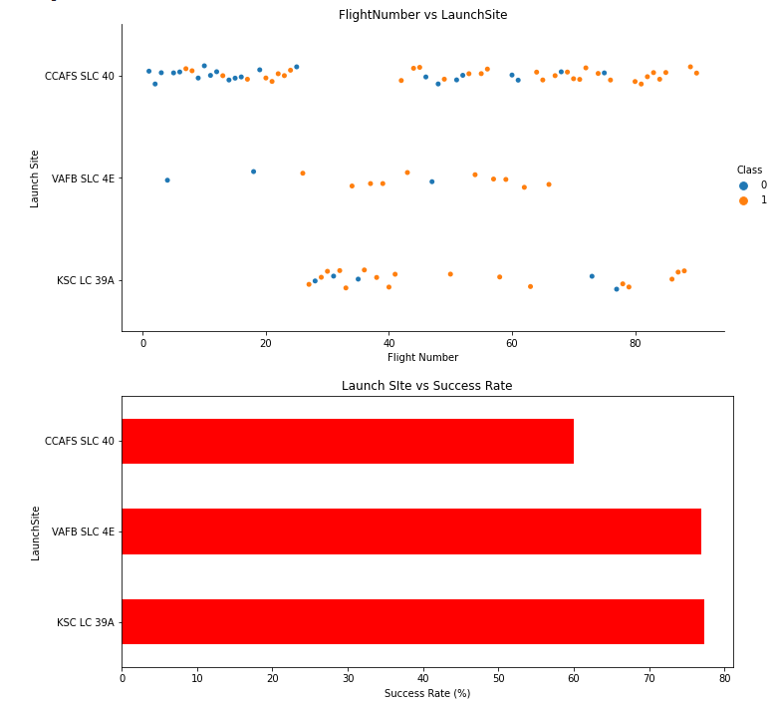
Flight Number vs. Launch Site
It appears that there were more successful landings as the flight numbers increased. It also seems that launch site CCAFS SLC 40 had the most number of landing attempts while the site VAFB SLC 4E had the least number of attempts.
Looking at the second chart, we can see that there is no Launch Site with a success rate below 60%.

Slide 19
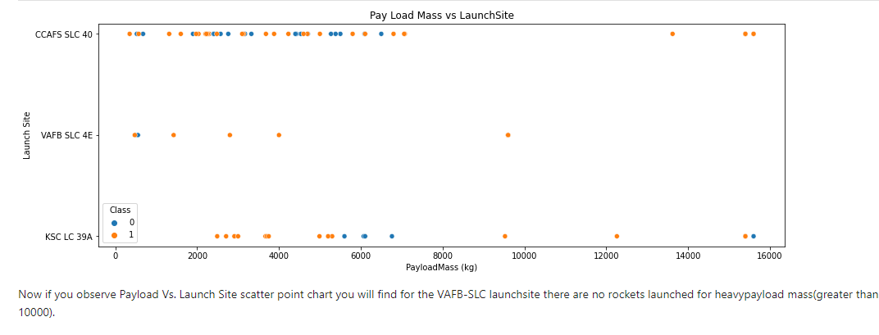
Payload vs. Launch Site
Now if you observe the scatter point chart, you will find for the VAFB-SLC launch site there are no rockets launched for heavy payload mass(greater than 10000).

Slide 20
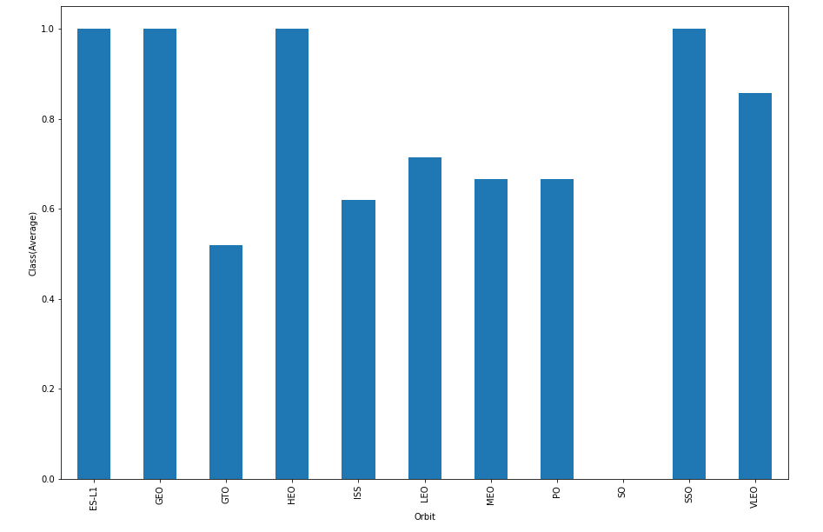
Success Rate vs. Orbit Type
The orbit types SSO, HEO, GEO and ES-L1 had the highest success rate.

Slide 21
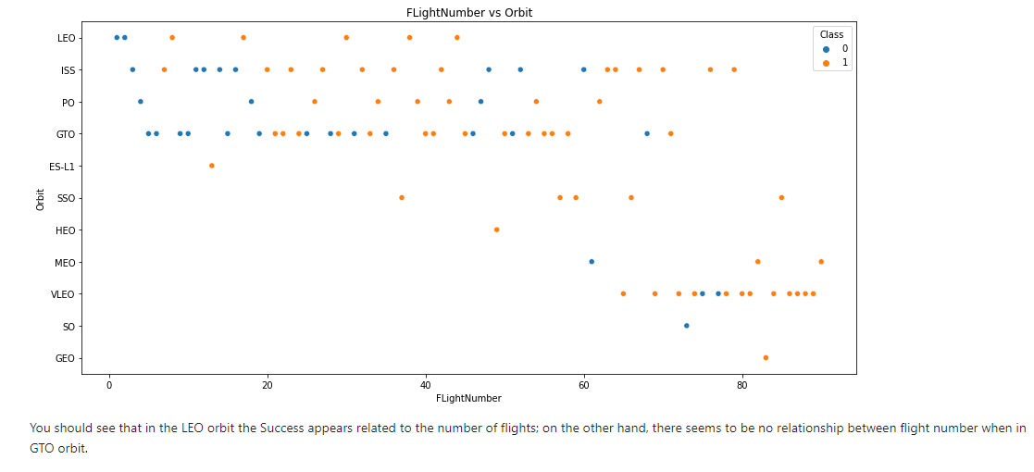
Flight Number vs. Orbit Type
You can see that in the LEO orbit the Success appears related to the number of flights; on the other hand, there seems to be no relationship between flight number when in GTO orbit.

Slide 22
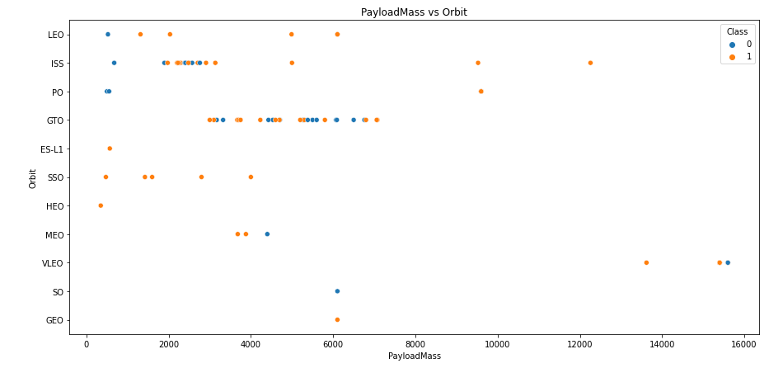
Payload vs. Orbit Type
With heavy payloads the successful landing or positive landing rate are more for Polar, LEO and ISS.
However for GTO we cannot distinguish this well as both positive landing rate and negative landing(unsuccessful mission) are both there.

Slide 23
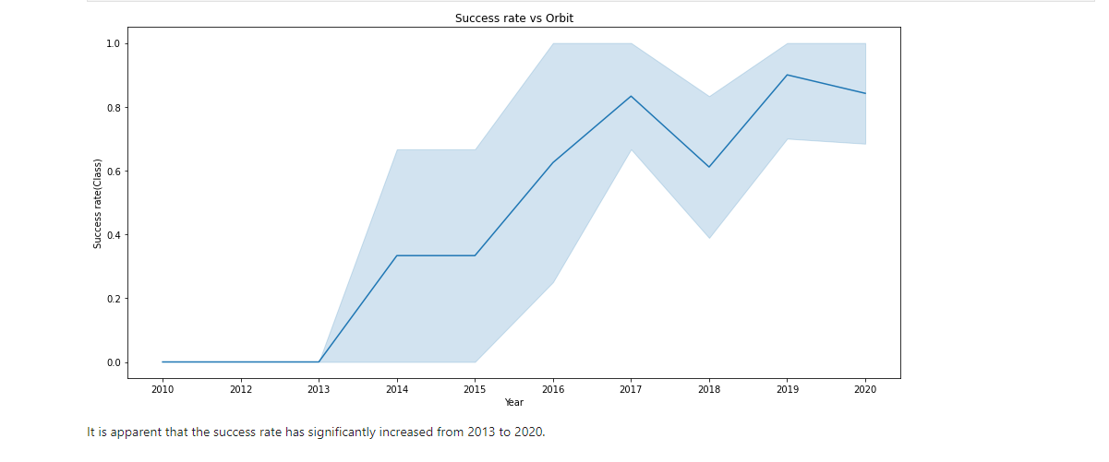
Launch Success Yearly Trend
It is apparent that the success rate has significantly increased from 2013 to 2020.

Slide 24
All Launch Site Names
Given the data, these are the names of the launch sites where different rocket landings where attempted:
CCAFS LC-40
CCAFS SLC-40
KSC LC-39A
VAFB SLC-4E

Slide 25
Launch Site Names Beginning with 'CCA'
Date | Launch_Site | Orbit | Customer | Mission_Outcome | Landing_Outcome
04-06-2010 | CCAFS LC-40 | LEO | SpaceX | Success | Failure (parachute)
08-12-2010 | CCAFS LC-40 | LEO (ISS) | NASA (COTS) NRO | Success | Failure (parachute)
22-05-2012 | CCAFS LC-40 | LEO (ISS) | NASA (COTS) | Success | No attempt
08-10-2012 | CCAFS LC-40 | LEO (ISS) | NASA (CRS) | Success | No attempt
01-03-2013 | CCAFS LC-40 | LEO (ISS) | NASA (CRS) | Success | No attempt
These are 5 records where launch sites begin with the letters 'CCA'. As we can see, there are other organizations besides SpaceX that were testing their rockets.

Slide 26
Total Payload Mass
The information in the table displays the total payload mass carried by boosters launched by NASA .
It seems that NASA (CRS) had a significantly higher total payload mass compared to the rest.
Customer | Total_Payload_Mass
NASA (CRS) | 45596
NASA (CCDev) | 12530
NASA (CCP) | 12500
NASA (CCD) | 12055
NASA (CTS) | 12050
NASA (CRS), Kacific 1 | 2617
NASA / NOAA / ESA / EUMETSAT | 1192
NASA (LSP) NOAA CNES | 553
NASA (COTS) | 525
NASA (LSP) | 362
NASA (COTS) NRO | 0

Slide 27
Average Payload Mass by F9 v1.1
Average_Payload_Mass (kg) | Booster_Version
2928.4 | F9 v1.1
The average payload mass carried by F9 v1.1 was 2928.4 kg.

Slide 28
First Successful Ground Landing Date
Date | Landing_Outcome
22-12-2015 | Success (ground pad)
The first successful ground pad landing took place in December 2015. This was a historic reusable-rocket milestone for both SpaceX and the world.
Prior to this, no one had ever brought an orbital class booster back intact.

Slide 29
Successful Drone Ship Landing with Payload between 4000 and 6000
Booster_Version | PAYLOAD_MASS__KG_ | Landing_Outcome
F9 FT B1022 | 4696 | Success (drone ship)
F9 FT B1026 | 4600 | Success (drone ship)
F9 FT B1021.2 | 5300 | Success (drone ship)
F9 FT B1031.2 | 5200 | Success (drone ship)
It appears that there only 4 Boosters with a payload mass between 4000 and 6000.
It is interesting to see that they all had successful landing outcomes.

Slide 30
Total Number of Successful and Failure Mission Outcomes
Mission_Outcome | Outcomes
Failure (in flight) | 1
Success | 99
Success (payload status unclear) | 1
It appears that missions generally tend to be successful with the exception of one failure.

Slide 31
Boosters That Carried the Maximum Payload Mass
12 boosters have carried the maximum payload mass of 15600 kg.
Since the version names are similar, they might be from the same manufactures.
Booster_Version | PAYLOAD_MASS__KG_
F9 B5 B1048.4 | 15600
F9 B5 B1049.4 | 15600
F9 B5 B1051.3 | 15600
F9 B5 B1056.4 | 15600
F9 B5 B1048.5 | 15600
F9 B5 B1051.4 | 15600
F9 B5 B1049.5 | 15600
F9 B5 B1060.2 | 15600
F9 B5 B1058.3 | 15600
F9 B5 B1051.6 | 15600
F9 B5 B1060.3 | 15600
F9 B5 B1049.7 | 15600

Slide 32
2015 Launch Records - Failed Landing Outcomes
Date | Launch_Site | Booster_Version | Landing_Outcome
10-01-2015 | CCAFS LC-40 | F9 v1.1 B1012 | Failure (drone ship)
14-04-2015 | CCAFS LC-40 | F9 v1.1 B1015 | Failure (drone ship)
It appears that 2 boosters failed to land at the beginnnig of the year..
The first successful landing took place later that year in December as we saw earlier.

Slide 33
Rank Landing Outcomes Between 2010-06-04 and 2017-03-20
If we observe the table, it is apparent that the number of successful landings have increased since 2015.
Before 2013, it seems that there were no attempts to land the boosters.
_date_ | Landing_Outcome | Outcomes
2016-04-08 | Success (drone ship) | 14
2015-12-22 | Success (ground pad) | 9
2015-06-28 | Precluded (drone ship) | 1
2015-01-10 | Failure (drone ship) | 5
2014-04-18 | Controlled (ocean) | 5
2013-09-29 | Uncontrolled (ocean) | 2
2012-05-22 | No attempt | 22

Slide 34

Section 3

Slide 35
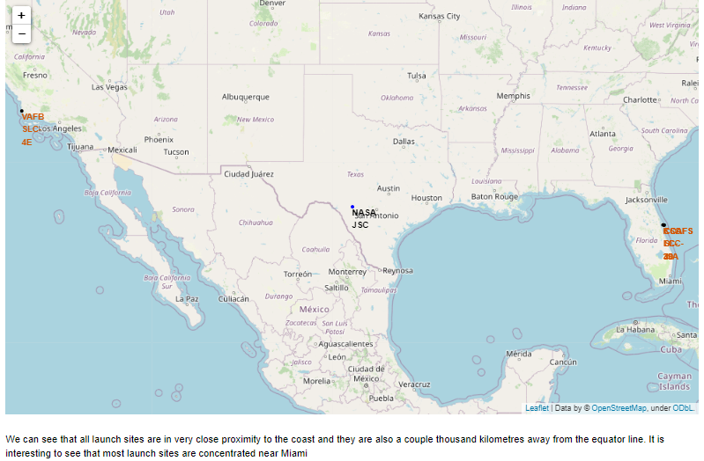
Launch Site Locations
We can see that all launch sites are in very close proximity to the coast and they are also a couple thousand kilometers away from the equator line.
It is interesting to see that most launch sites are concentrated near Miami.

Slide 36
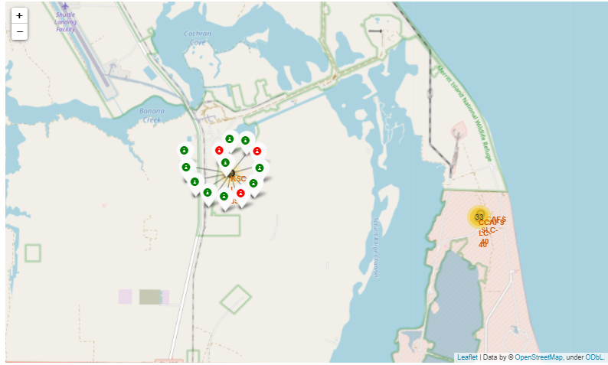
Success Rate of Rocket Launches
The successful launches are represented by a green marker while the red marker represents failed rocket launches.
It appears that KSC LC-39A had the highest success rate of rocket launches compared to other launch sites.

Slide 37
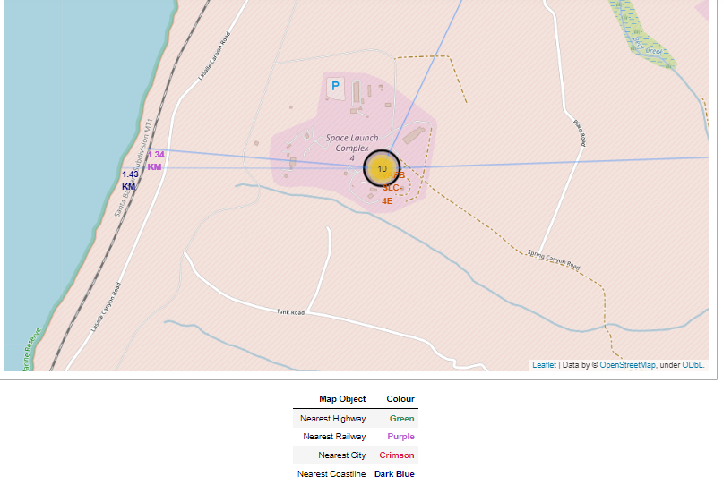
Surrounding Landmarks
It appears that launch sites are usually set up at least 18 km away from cities. This may be because of the desire to prevent any crashes near populated areas.
It is also apparent that launch sites are in very close proximity to railways and highways. Perhaps, due to the necessary transportation requirements for rocket parts.
The sites are close the coast line. This is evident with the many rocket landing tests on water bodies like the ocean.

Slide 38

Section 4

Slide 39
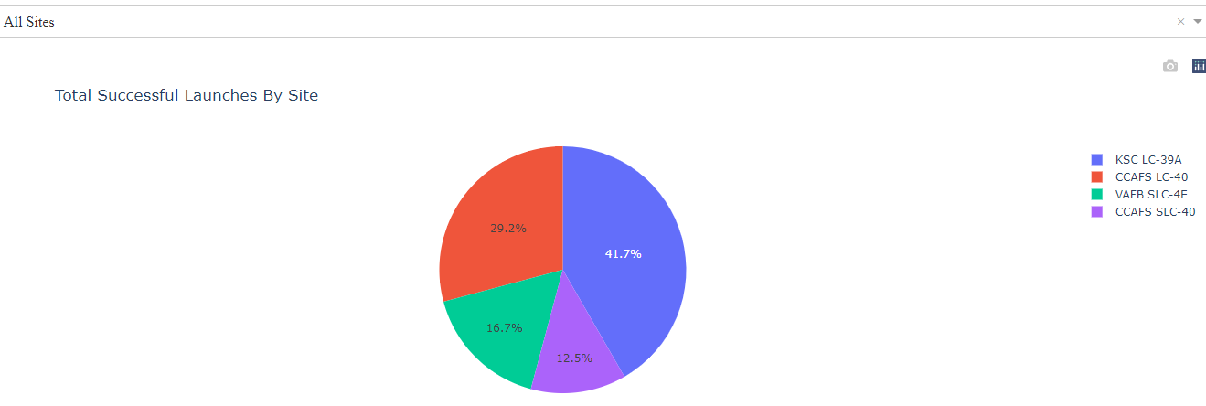
Successful Launches by Site
Site KSC LC-39A has the largest successful launches as well the highest launch success rate.
More investigation may be needed to determine why KSC LC-39A is the preferred launch site.

Slide 40
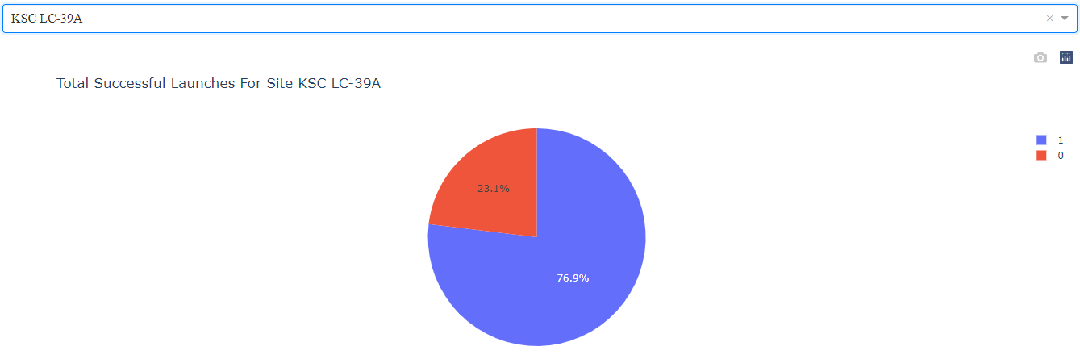
Total Successful Launches for Site KSC LC-39A
As we can see, 76.9% of the total launches at site KSC LC-39A were successful. This is a the highest success rate of all the different launch sites.
However, this success rate was only around 3% higher than the runner up; site CCAFS LC-40.

Slide 41
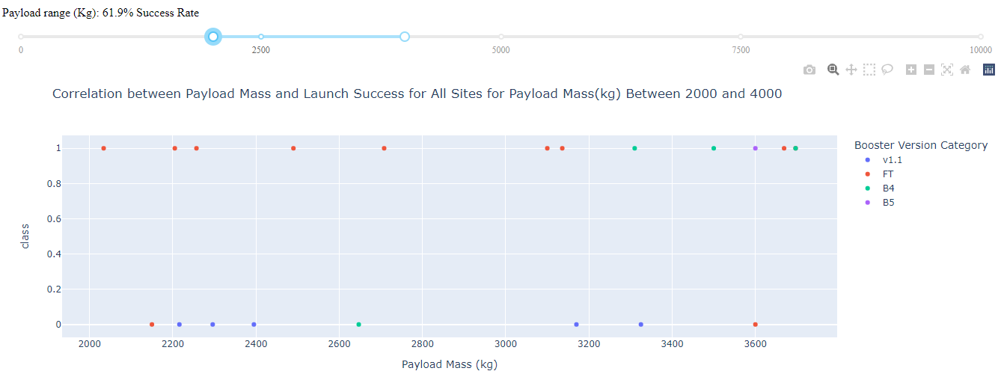
Payload Mass vs. Launch Success for All Sites
It appears that the payload range between 2000 kg and 4000 kg has the highest success rate.
The launch success rate was also dramatically low between the payload range of 0kg and 2500kg. Perhaps very low masses decrease launch success.
The booster version FT, seems to have a higher success rate than other booster versions

Slide 42

Section 5

Slide 43
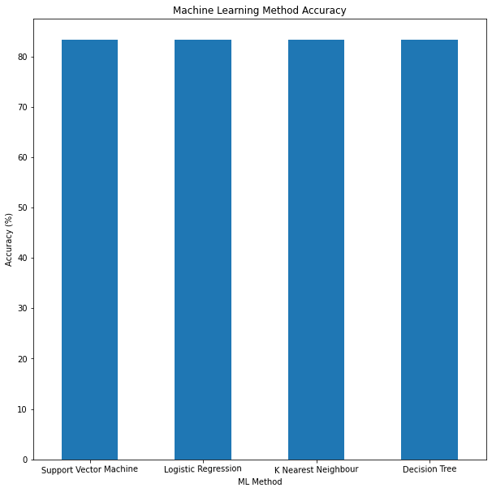
Classification Accuracy
Since all the methods have an identical accuracy score of 83.33%, we decided to use Logistic Regression for the classification

Slide 44
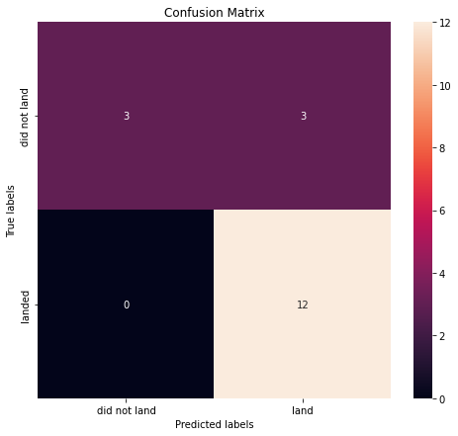
Confusion Matrix
The chart shows the confusion matrix of the Logistic Regression model that was chosen.
The model only failed to accurately predict 3 labels.

Slide 45
Conclusions
In order to compete with SpaceX, it was crucial to analyze their data. Through this process, a general picture of their success methods was produced.
All their launch sites are located near the coast, away from nearby cities. This enabled to them to test their rocket landings without much interference.
Site KSC LC-39A had the highest launch success rate out of all the launch sites.
From 2015 onwards, the success rate of rocket landings significantly increased. It was also apparent that landing success increased with flight number
All this data was used to train a machine learning model that is able to predict the landing outcome of rocket launches with 83.33% accuracy.
This will allow our company to make more attractive offers than SpaceX and increase the confidence of our investors and customers. Can anyone say “No” to a company that can predict the success of their product?

Slide 46
References
Fortune Business Insights (2020). Space launch services market. https://www.fortunebusinessinsights.com/industry-reports/space-launch-services-market-101931
CB Insights. The Top 12 Reasons Startups Fail. https://www.cbinsights.com/research/startup-failure-reasons-top/
IBM. Data Science Professional Certificate. https://www.coursera.org/professional-certificates/ibm-data-science
Space.com. SpaceX Lands Orbital Rocket Successfully in Historic First. https://www.space.com/31420-spacex-rocket-landing-success.html

Slide 47
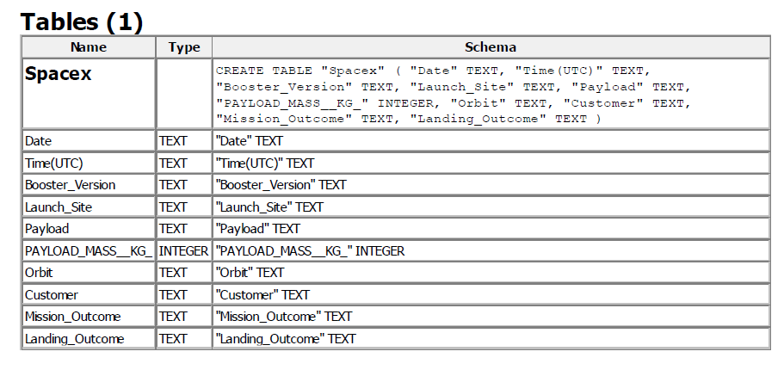
Appendix
SQLite Data Set
The table structure belongs to the SQLite data set used for SQL queries.
URL link: https://github.com/Felipekohut/SpaceX-Landing-Prediction/tree/main/Datasets_Created

Slide 48


